Slide 1
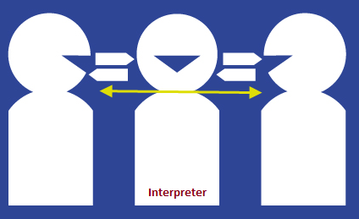
Interpreter
1. Be prepared to summarise the story that is told to you in English.
2. Make sure to make notes while you listen!
Notes:
Use an authentic Chinese story (catered to the level of your students) e.g. the story of Nian.
Tell the story slowly and clearly and use pictures and/or gestures to provide an extra scaffold to aid their understanding.
Pick students at random to retell the story in English and use peer feedback to fill in any gaps in their interpretation.

